Slide 1


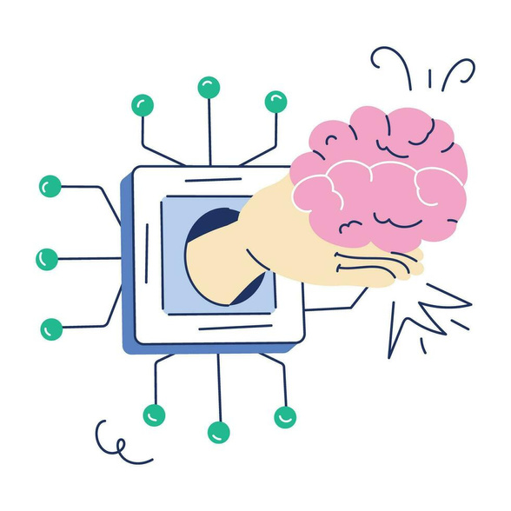
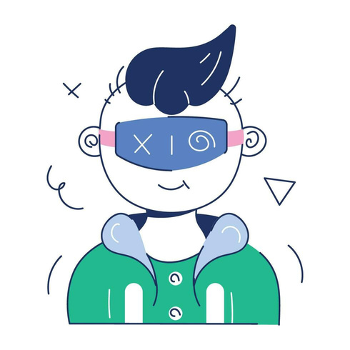
Deep Learning Based Adaptive Image Anonymization System
Submitted To: Dr Amit Chauhan
Assistant Professor
SCSET, Bennett University
Presented By: Keshav
E23CSEU1538

Slide 2

Contents
Introduction
Literature Review
Workflow
Dataset
Results
References
Thank You

Slide 3



Introduction
Images often contain PII (faces, IDs, numbers, addresses).
Manual blurring is slow, inconsistent and not scalable.
Aim: build an AI-powered adaptive anonymizer that automatically detects sensitive regions.
Model decides the best masking method: Blur, Pixelate or Black-box.
System works across faces, documents, Aadhaar, and license plates.

Slide 4
Literature Review
Sr.no. | Title & Authors | Dataset | Work Done | Limitation/ Future work
1. | Q. Sun et al., Head Inpainting (CVPR 2018) | CelebA | Face anonymization using GANs | Heavy, face-only, needs faster models
2. | C. Clausner et al., ICDAR Text Reading (2019) | ICDAR | Text detection & OCR benchmarking | No anonymization; combine with privacy tools
3. | S. Montazzolli et al., LP Detection via CNN (2020) | License Plates | Real-time license plate detection | Limited to vehicles; expand to general PII
4. | M. Tan & Q. Le, EfficientNet (ICML 2019) | ImageNet | High-efficiency CNN architecture | Requires fine-tuning for specific tasks
5. | R. Shokri et al., Privacy Attacks on ML (2017) | ML Benchmarks | Shows privacy risks in ML models | No visual PII focus; add image anonymization

Slide 5

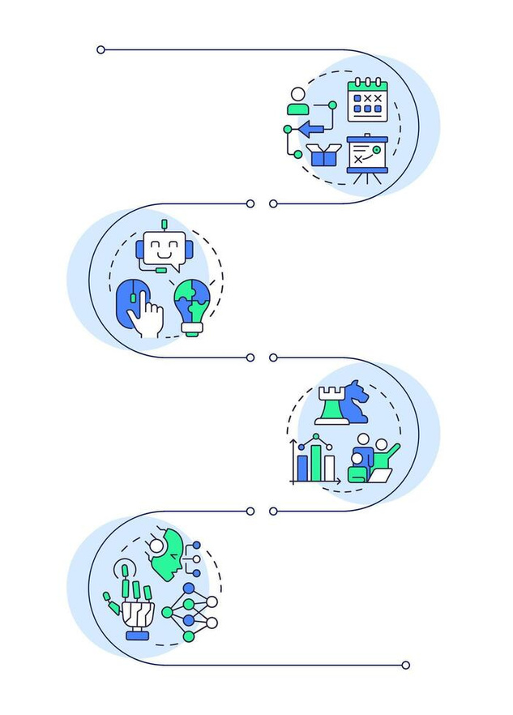
Workflow
Recursive dataset collection
Face detection using Mediapipe
Text detection using EasyOCR
Region cropping
Automatic labeling (heuristics)
EfficientNetB0 training (3-class classifier)
Mask application during inference (Blur/Pixel/Black)
Batch anonymization + saving results

Slide 6
Dataset
Four datasets used:
CelebA: large-scale face dataset
USA Driver License dataset: synthetic IDs
License Plate Dataset: vehicle LPs
Aadhaar card dataset: synthetic text-heavy IDs
Dataset Prep:
Recursive crawling for deep folder structures
Region extraction using face + text detection
Cropped images labeled into 3 classes

Slide 7

Model (EfficientNet-B0)
Lightweight yet powerful CNN architecture
Input: 224×224 region crop
Output: { Blur (0), Pixelate (1), Black-box (2) }
Pretrained weights on ImageNet
Fine-tuned using custom dataset
Normalization and augmentation used for robustness

Slide 8
TRAINING SETUP
Framework: PyTorch
Optimizer: AdamW
Loss: Cross Entropy
Train/Val Split: 85/15
10 Epochs
GPU accelerated training
Best model saved as:
efficientnet_adaptive_masker_final.pth

Slide 9
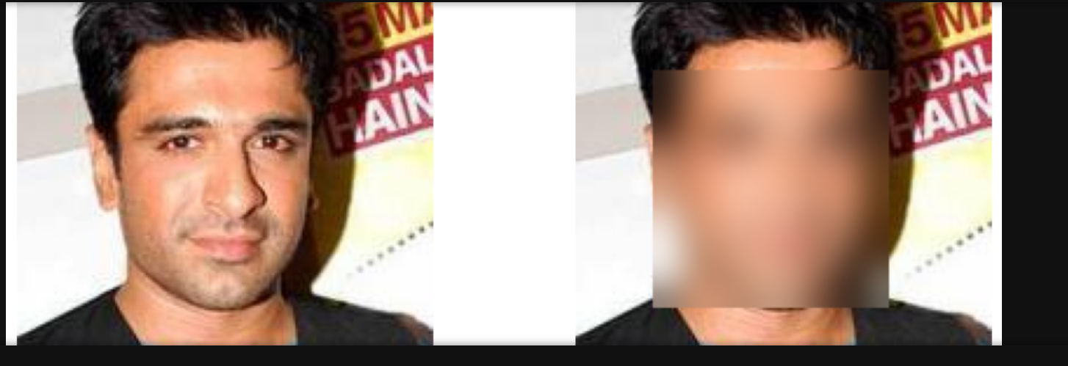
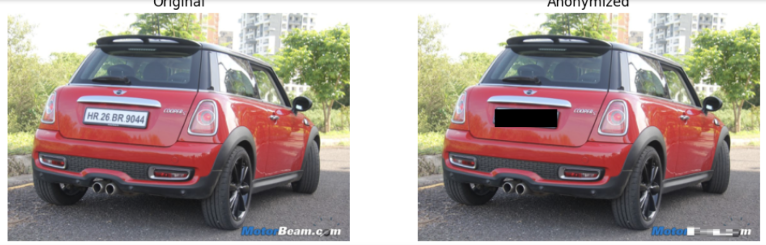
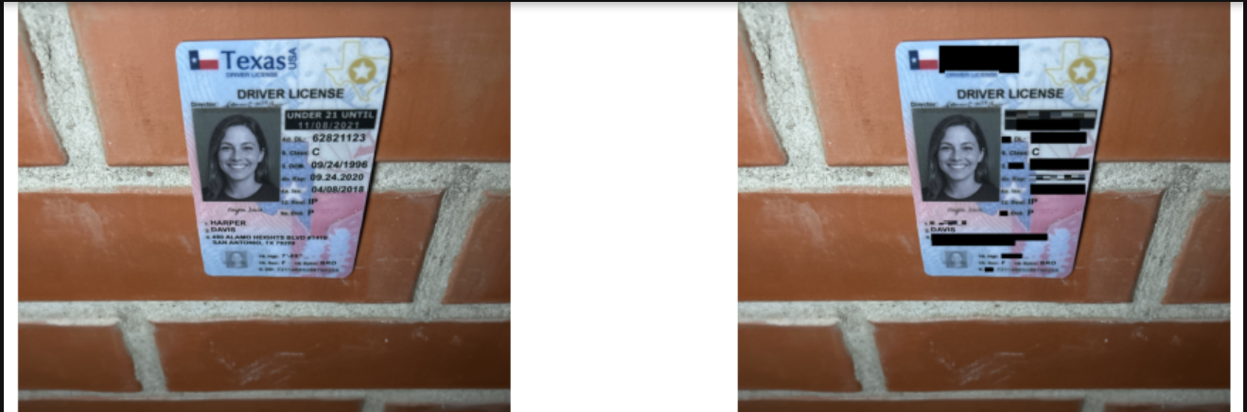
Face privacy
Car numbers
Ids infos

Slide 10
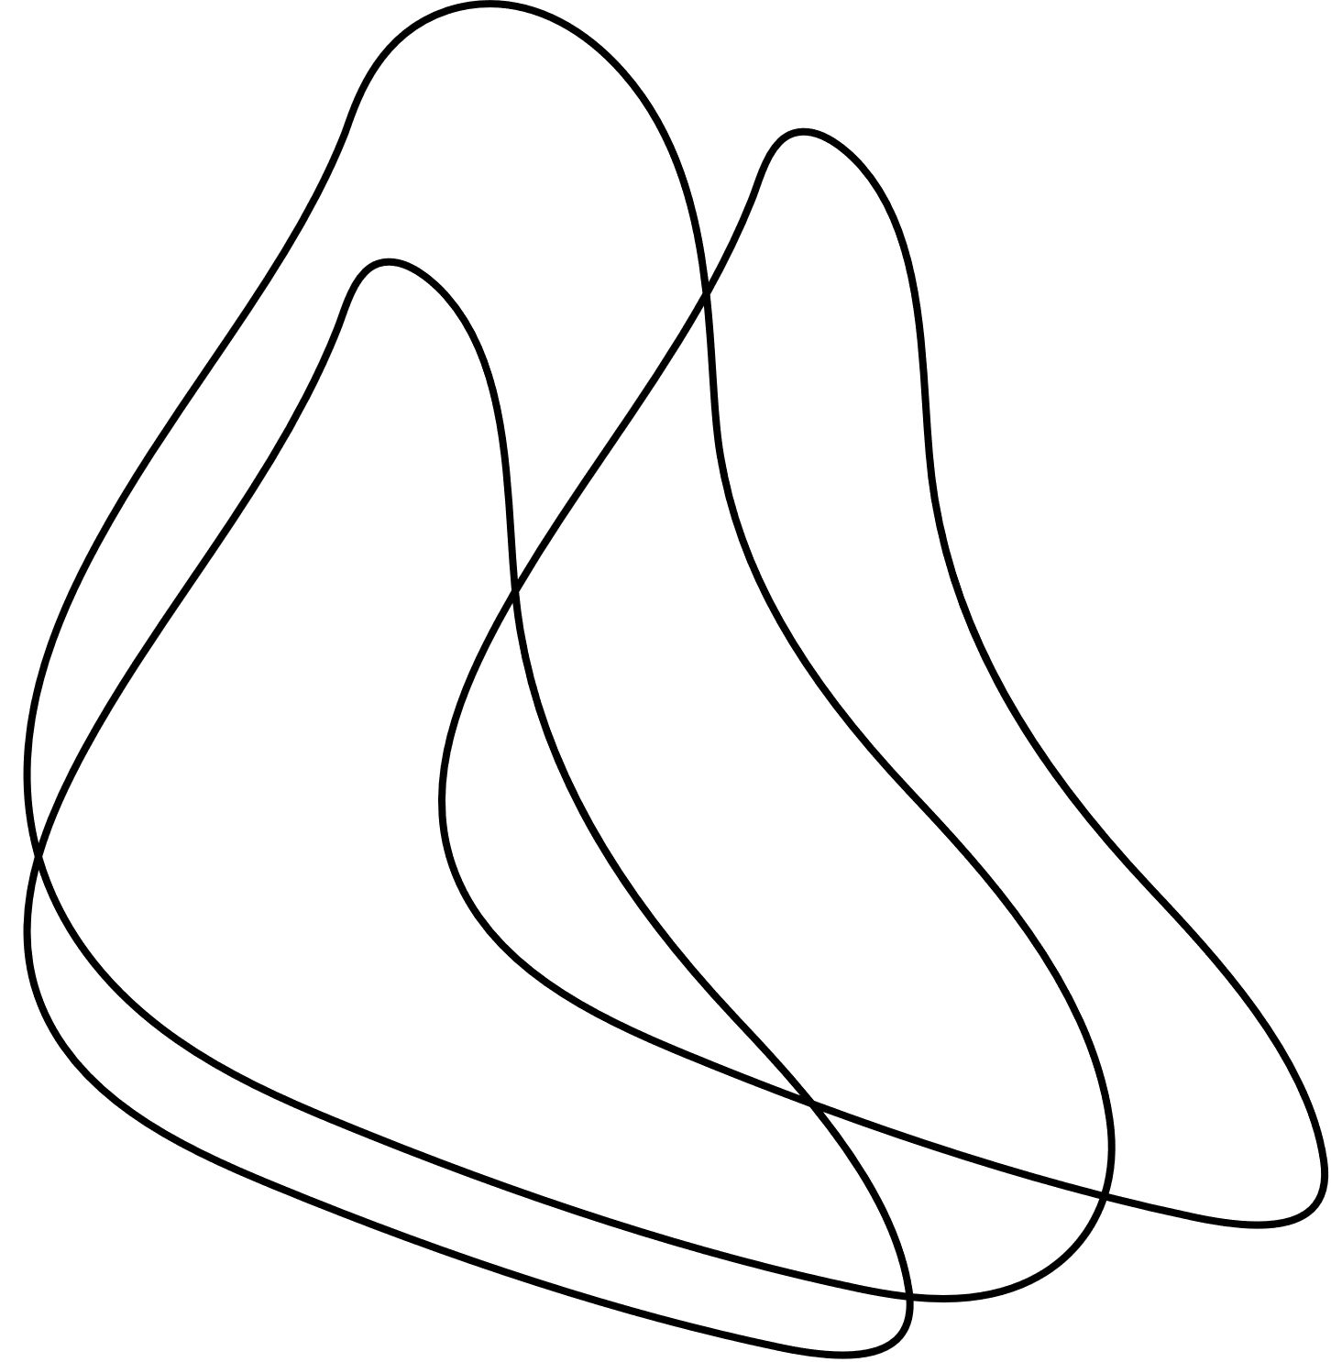

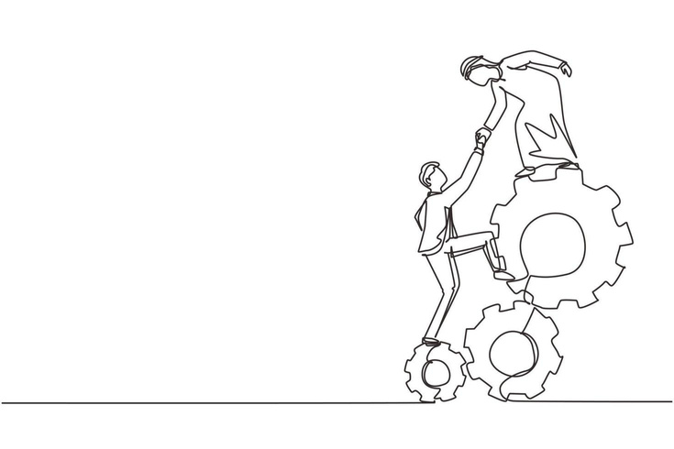


CONCLUSION
BUILT AN AI-BASED ADAPTIVE IMAGE ANONYMIZER
DETECTS FACES, TEXT & PII AUTOMATICALLY
EFFICIENTNET-B0 SELECTS BLUR / PIXEL / BLACK
WORKS ACROSS MULTIPLE DOCUMENT DATASETS
PROVIDES FAST AND CONSISTENT PRIVACY MASKING
“PRIVACY ISN’T OPTIONAL IN AI — IT’S THE CORE OF ETHICAL INTELLIGENCE.”

Slide 11
References
[1] Q. Sun et al., “Natural and Effective Obfuscation by Head Inpainting,” CVPR, 2018.
[2] C. Clausner et al., “ICDAR2019 Robust Reading Challenge,” ICDAR, 2019.
[3] S. Montazzolli and C. Jung, “LP Detection using Deep CNN,” IEEE Trans. ITS, 2020.
[4] M. Tan and Q. Le, “EfficientNet: Rethinking Model Scaling,” ICML, 2019.
[5] R. Shokri et al., “Membership Inference Attacks Against ML Models,” IEEE S&P, 2017.

Slide 12
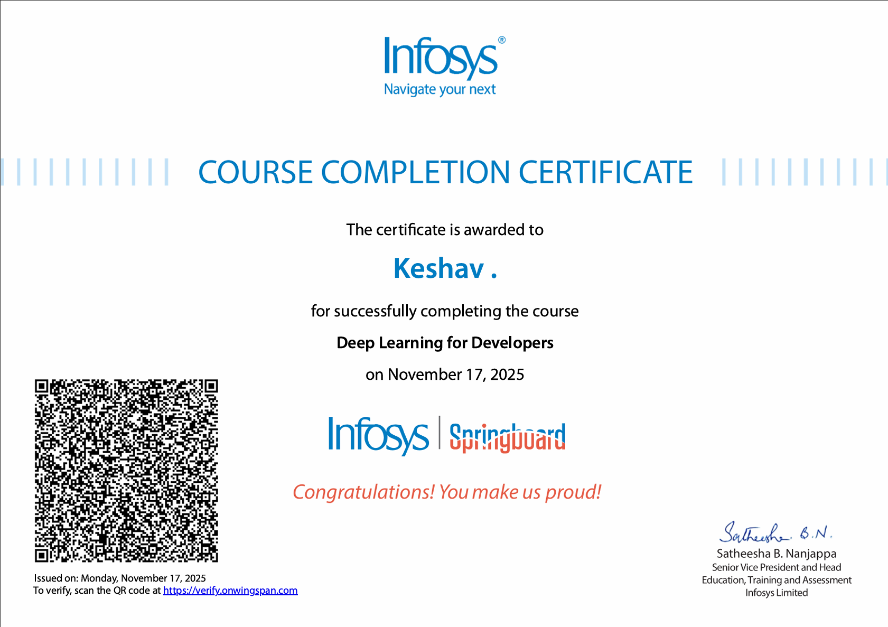

Slide 13





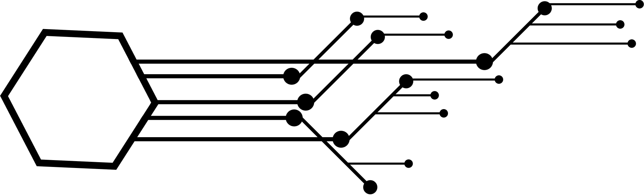




KESHAV

